Slide 1
BAIT2203 Human Computer Interaction
Wechat Application System
Lim Jun Wei
Chia Ming Yi
Ong Yi Xin
Ng Ian Kai

Slide 2
Proposal

Slide 3
Introduction

Slide 4
Introduction
WeChat
leading social media platform.
serves millions of users globally.
wide array of features, but several functionality issues persists.
Proposed System
aims at addressing the deficiencies in WeChat.
aims to enhance overall user experience.

Slide 5
Introduction
Functionality Issues
unable to reply to messages with quick gestures
unable to navigate to a message’s position in the chat
unable to reply to messages by pictures, stickers, or voice messages
unable to adjust the playback speed of a voice message
unable to see the online status or last active time
unable to delete message after 2 minutes
unable to edit sent messages
unable to style messages
unable to star or pin messages
unable to backup data in the cloud
no noise cancellation feature for calls
unable to start a vote or poll
Target audiences
personal users
businesses
organizations
frequent communicators
professional users
social media enthusiasts

Slide 6
PACT Analysis

Slide 7
People
Age Group
Below 18 years old:
developing new abilities and skills
High curiousness
Between 18 to 24 years old:
Desire to expand social cycle
Love to customize their own components
Use various online social platforms
Follow the latest trend and interesting design

Slide 8
People
Between 25 to 50 years old:
Focus on high efficiency design & features
Keep track of workspace pace
Use messaging application
Make payment using smartphone
Over 51 years old:
Perceive simple and understandable info
Use messaging application
Receive info using auditory sense
Tend to maintain body health

Slide 9
People
Language
People will more prefer their own mother language
Example:
Malay: Prefer Bahasa Melayu
Chinese: Prefer Mandarin
Indian: Prefer Tamil
People have to spend time to do translation when facing with unfamiliar language

Slide 10
People
Congenital disabilities
Overcome pain in most scenarios everyday
Blind person:
Prefer to perceive info via auditory sense or tactile sense
Deaf person:
Prefer to perceive info via visual sense

Slide 11
Activities - Kids
Timeline | Activities
6.30 am | Wake up Take breakfast Go to school
3.00 pm | Go back home Take shower Accomplish school tasks and projects at home Discuss school tasks with classmates
5.30 pm | Play games
7.00 pm | Have dinner Chit chat with friends via online
9.00 pm | Go to bed

Slide 12
Activities - Secondary School Students
Timeline | Activities
6.00 am | Check messages and notifications Check school announcements and updates
8.00 pm | Discuss assignments Ask questions on school group chat Share class notes Access education mini programs
3.00 pm | Join co-curricular activities and clubs Communicate with club members Receive announcement regarding to activities

Slide 13
Activities - Secondary School Students
Timeline | Activities
6.00 pm | Complete homework Pre-study tomorrow’s class content Form study group via online
9.00 pm | Entertainment Share interesting moments at school via online Go to bed

Slide 14
Activities - Office Workers
Timeline | Activities
6.00 am | Check messages and notifications Read latest news posted
8.30 am | Work at company office Communicate with colleagues
12.00 pm | Having lunch at restaurant Payment via transferring money using smartphone
9.00 pm | Watch short videos using smartphone or tablets

Slide 15
Activities - Retirees or Elders
Timeline | Activities
6.00 am | Read news articles via online or newspaper Obtain health tips and wellness info
9.00 am | Communicate with family members Ask for help from childs
12.00 pm | Order food at restaurant or via food delivery Make transaction using smartphone
7.00 pm | Video calls with children Watch videos via television or tablets

Slide 16
Context
Environment
Cooler
Right temperature
Noisy public transportation
Hot

Slide 17
Technology
Support almost all operating system
Accessible wider audience
Provide user convenience
Complex (Resource are intensive)
Vulnerability and data privacy

Slide 18
Technology
Convenient apps
Enhance user experience
Safer security and privacy
High Cost
Limit storage and resource usage

Slide 19
Technology
Graphic user interface (GUI)
User-friendly interface
Represent complex data
Complex for new users
Limited for visually impaired users

Slide 20
Technology
Voice interface
Hands-free
Perform task more faster
Accuracy
Privacy

Slide 21
Usability Goals

Slide 22
Effectiveness
Edit Sent Messages
Allows quick adjustments without deleting.
Ensures accurate communication and reduces misunderstandings.
Streamlines communication in professional settings.
Navigate to Original Message
Improves conversation continuity and understanding.
Helps users reference context easily, enhancing clarity in discussions.
Message Text Styling Options
Options like bold, italic, and strikethrough enhance message clarity.
Enables emphasis on key points and better organization of messages.
Visibility of User Online Status
Indicates availability for timely communication.
Reduces missed messages and fosters spontaneous interactions.

Slide 23
Efficiency
Gestures to Reply to Messages
Quick gestures enhance user convenience and interaction speed.
Simplifies the user interface for faster responses.
Reply with Pictures or Stickers
Adds expressiveness to conversations.
Enhances engagement and enjoyment in communication.
Reply to Voice Messages
Personalized interaction with voice replies.
Allows for nuanced communication and quicker exchanges.
Adjust Voice Message Playback Speed
Customizable playback enhances user control.
Facilitates efficient consumption of voice messages.

Slide 24
Satisfaction
Cloud Storage Backup Options
Ensures data security and easy access across devices.
Increases user confidence and prevents data loss.
Noise Cancellation in Video Calls
Enhances audio clarity for focused conversations.
Critical for both personal and professional communications.
Voting in Group Chats
Facilitates collaborative decision-making and participation.
Streamlines group interactions and enhances satisfaction.
Star Important Messages
Easy access to key details without searching through chat history.
Improves organization and enhances user experience.

Slide 25
Analysis Report

Slide 26
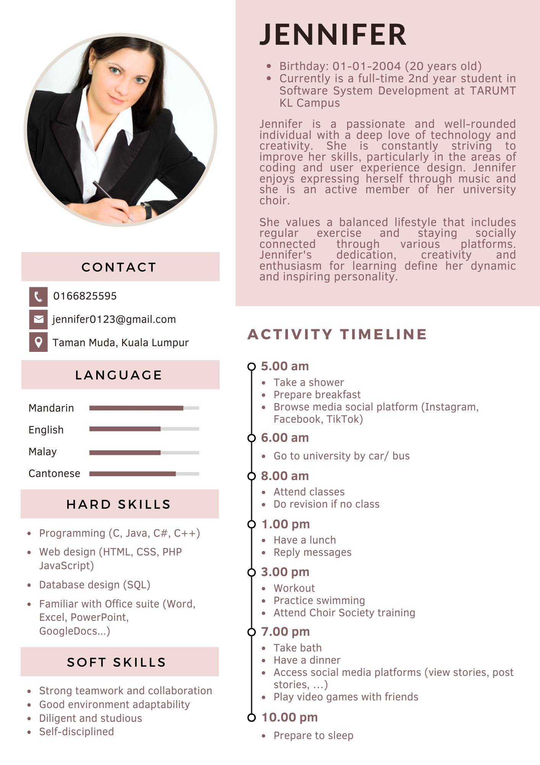
Persona

Slide 27
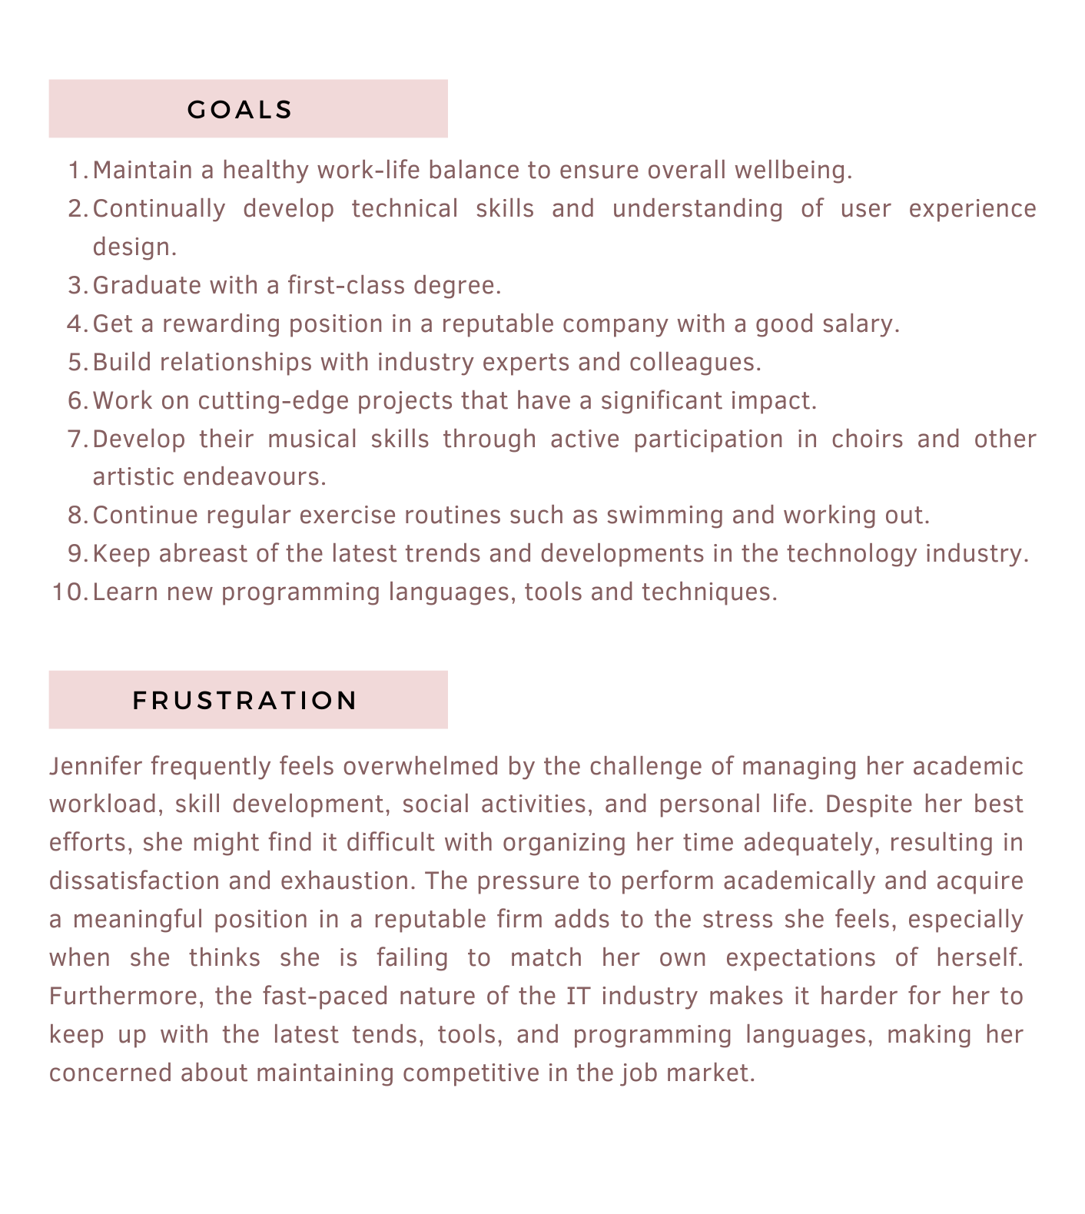
Persona

Slide 28
Task Analysis of Current Task
0. In order to have an online conversation with someone:
Open an online messaging platform.
Find the person you want to chat with.
2.1. Search for the person’s contact name.
2.2. Select the person from the search results.
2.3. Select the person from the contact list.
Send a message to initiate the conversation.
Engage in the conversation.
Enter and leave a voice conversation
Conclude the conversation.
Close the messaging platform.
Plan 0: do 1 - 2 - 3 - 4 - 6 - 7 in that order if the user wants to have a message conversation. Else if the user wants to have a voice conversation, do 1 - 2 - 5 - 6 - 7 in that order.
Plan 2: do any of 2.2 or 2.3 depending on how the user searched for the contact.

Slide 29
Scenario of Current Task
Jennifer is planning to travel abroad with her family members.
Ask Sam for some tripping recommendations
No status info shown on contact when Jennifer is trying to text to Sam.
No shortcut keys to highlights messages when Jennifer is typing long messages.

Slide 30
Scenario of Current Task
Jennifer can’t check whether Sam has read her messages.
Jennifer is not able to edit the message anymore after she sent her messages about 2 minutes.
Jennifer can’t reply to a message by voice message.

Slide 31
Environment Analysis
Environment during use
Indoors and outdoors
Hot or cold weather conditions
Period used
Throughout whole day
Frequent interruptions

Slide 32
Environment Analysis
Multiplier users
Digital tools that conjunction with
Google Drive or Dropbox
Microsoft Office or Google Workspace
Instagram or Facebook
Zoom or Microsoft Teams

Slide 33
Design & Prototyping

Slide 34
Preliminary Design

Slide 35
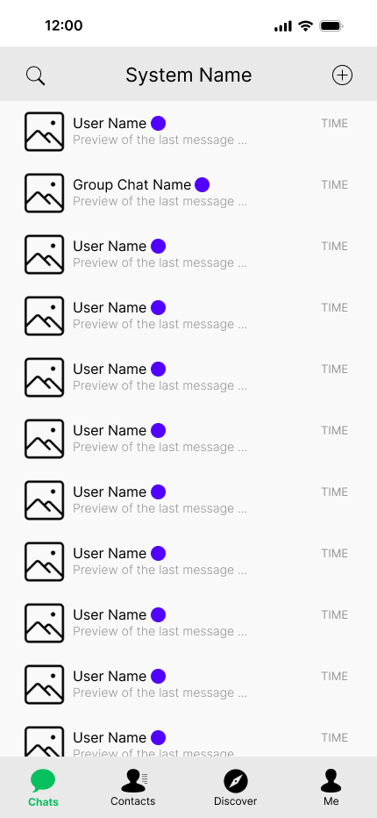
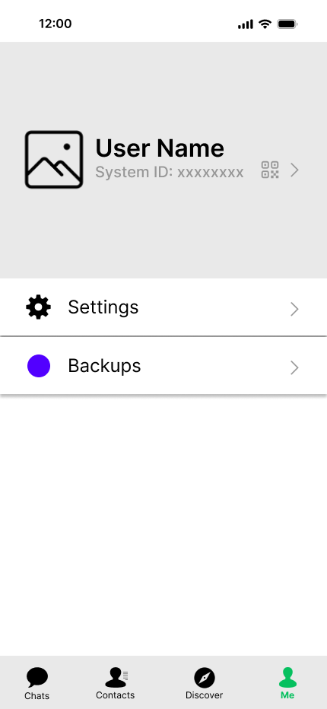
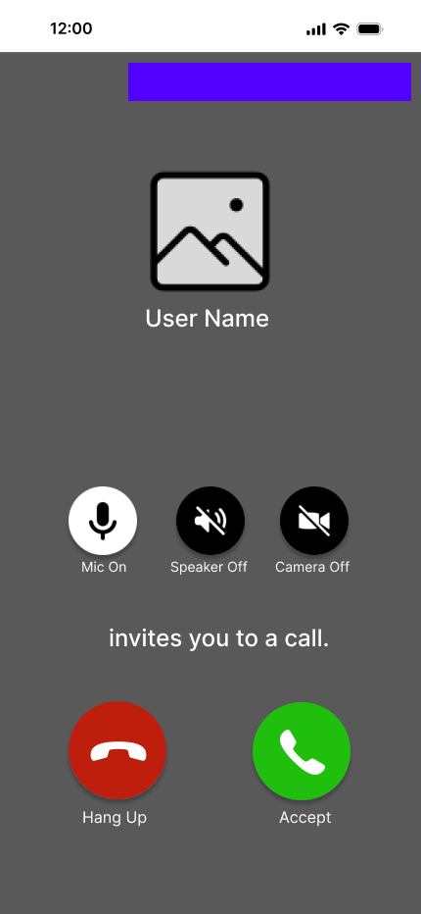
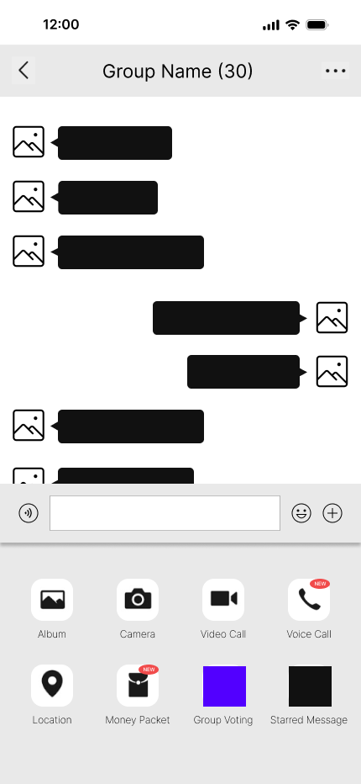
Page

Slide 36
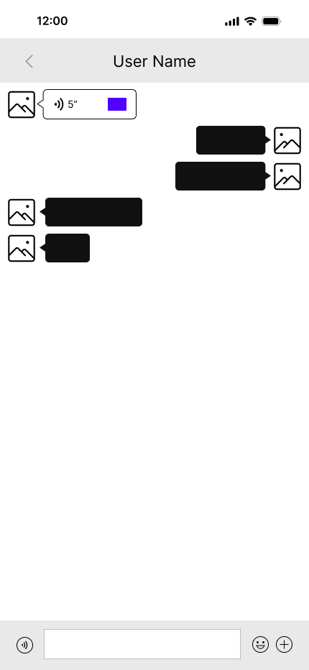
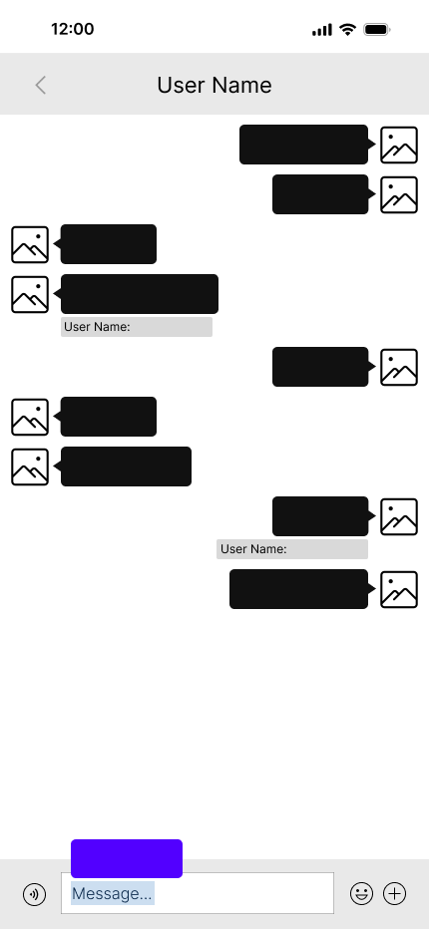
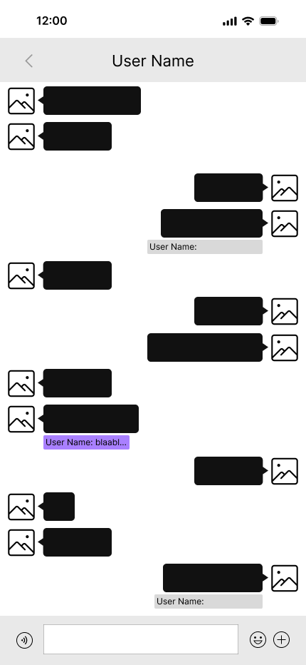
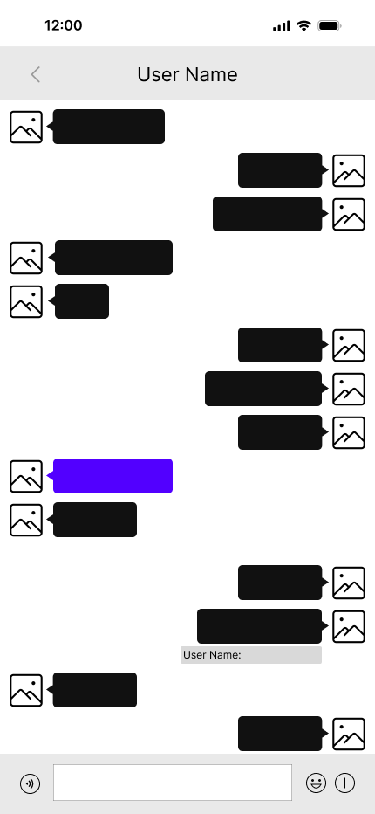
Page

Slide 37
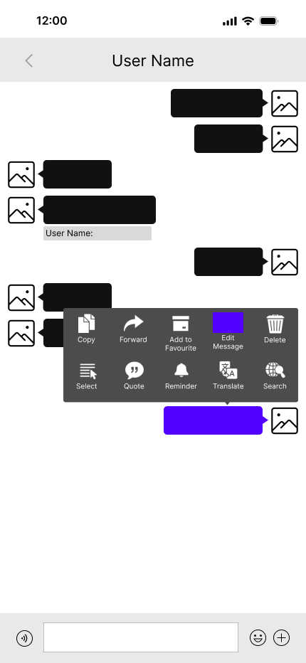
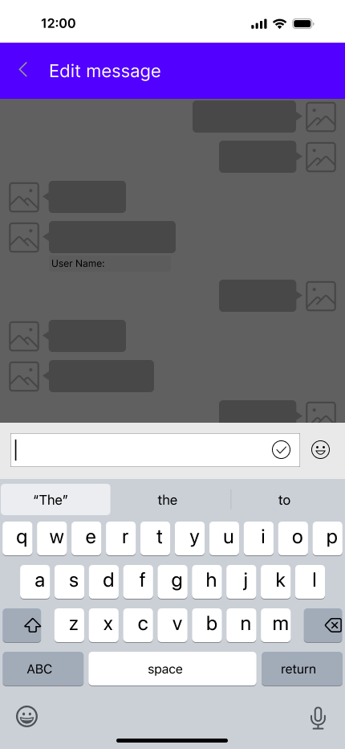
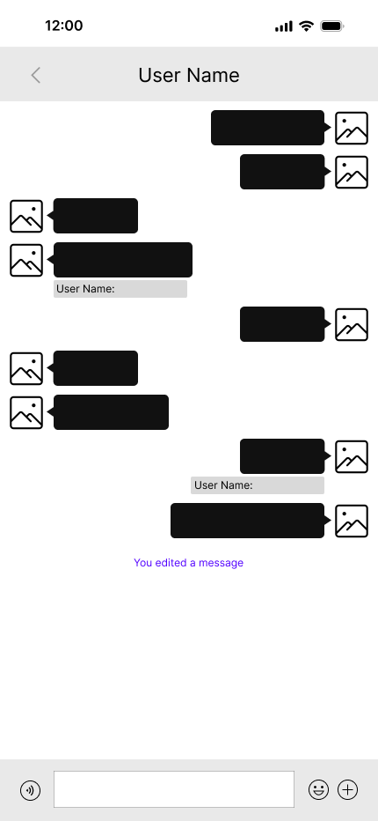
Page

Slide 38
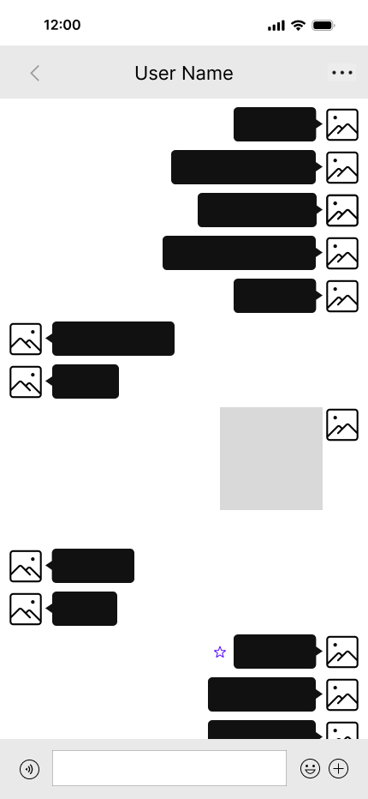
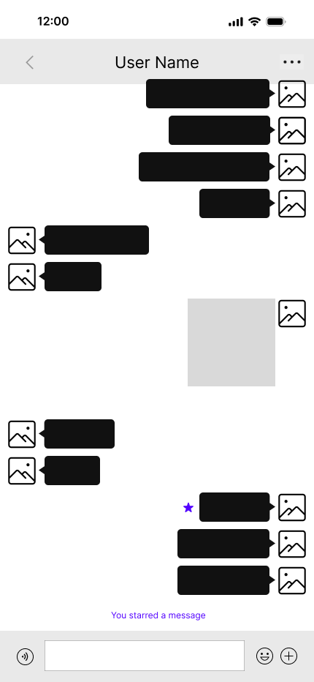
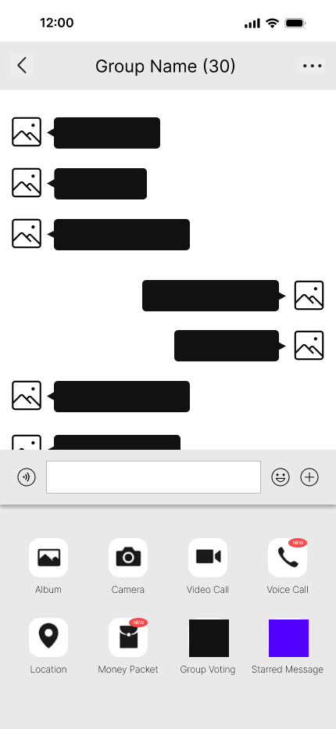
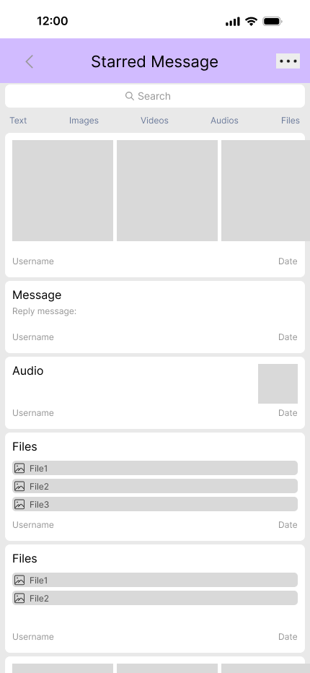
Page

Slide 39
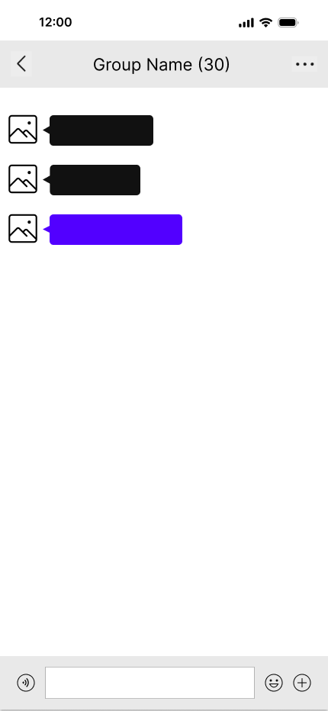
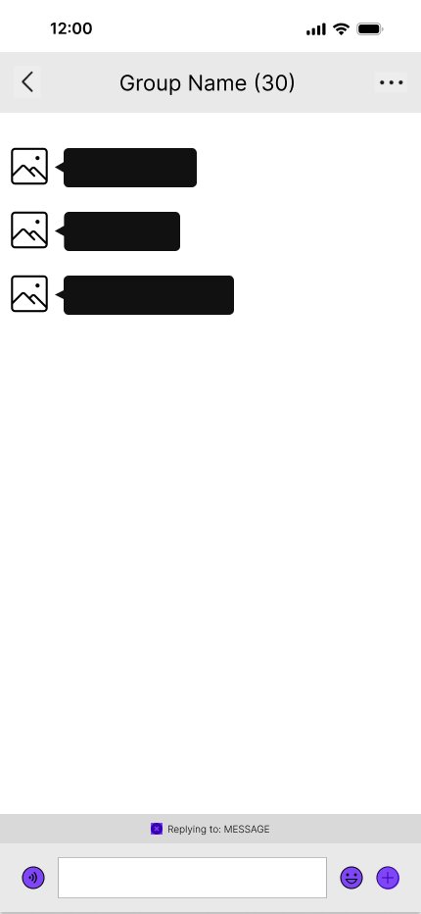
Page (Gestures to reply)

Slide 40
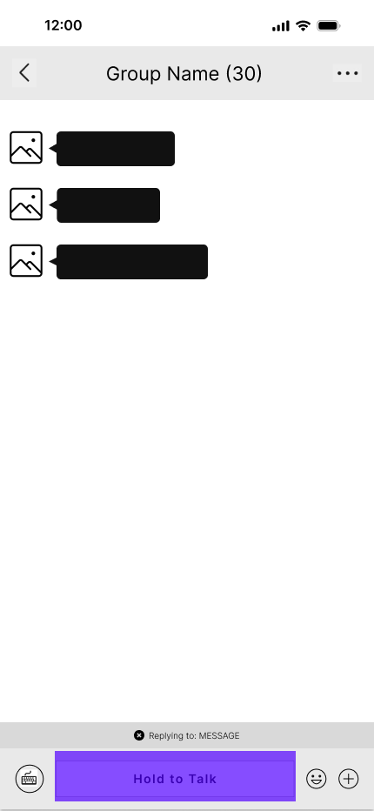
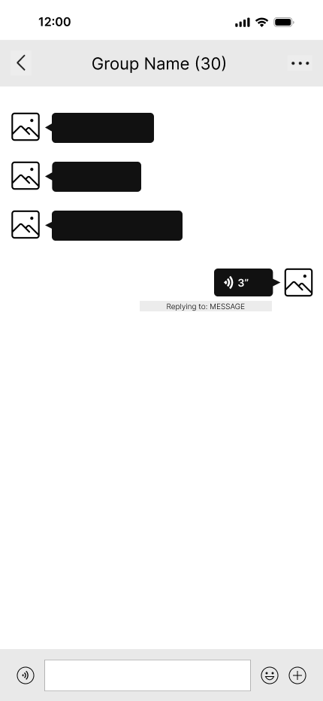
Page (Reply by voice message)

Slide 41
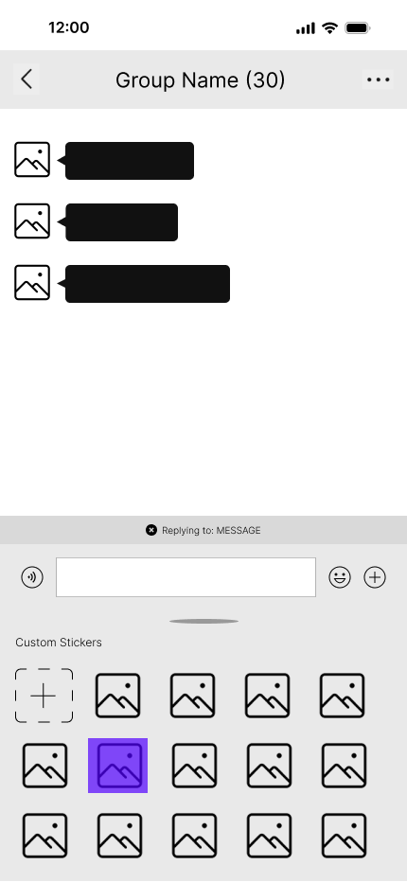
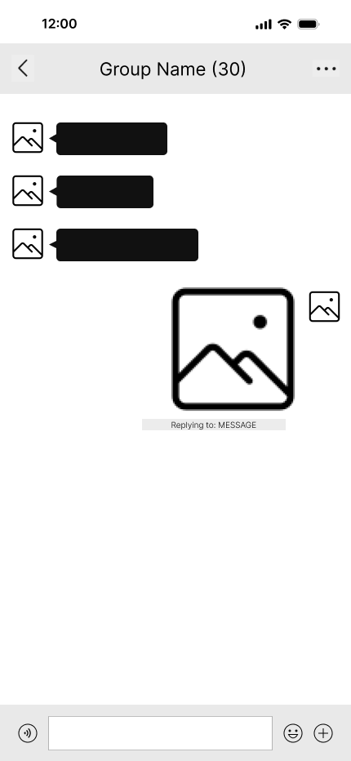
Page (Reply by sticker)

Slide 42
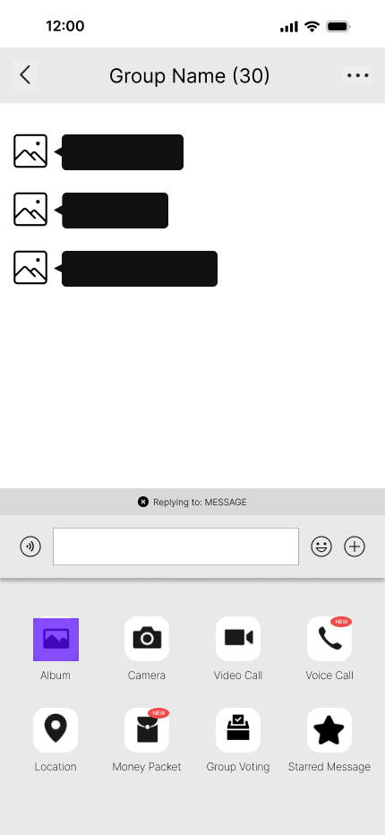
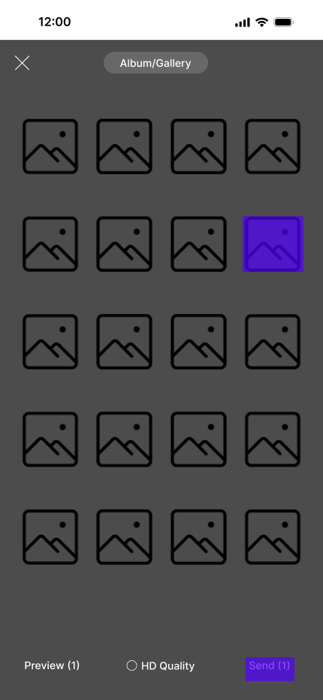
Page (Reply by picture)

Slide 43
Detail Design

Slide 44
Detail Design
https://www.figma.com/design/mj2rckEOYuKuLsV032r0Q1/BAIT2203-HUMAN-COMPUTER-INTERACTION-PROTOTYPE?node-id=135-312&node-type=canvas&t=iHrPXVdeKdDP1JuI-0

Slide 45
Design Decisions

Slide 46
Design Decisions
https://docs.google.com/document/d/1hyLJeKpIdYS7fN6Bdeeq4UHmvvJQsc-w50UCv8t5ipY/edit#heading=h.3znysh7

Slide 47
Heuristic Evaluation

Slide 48
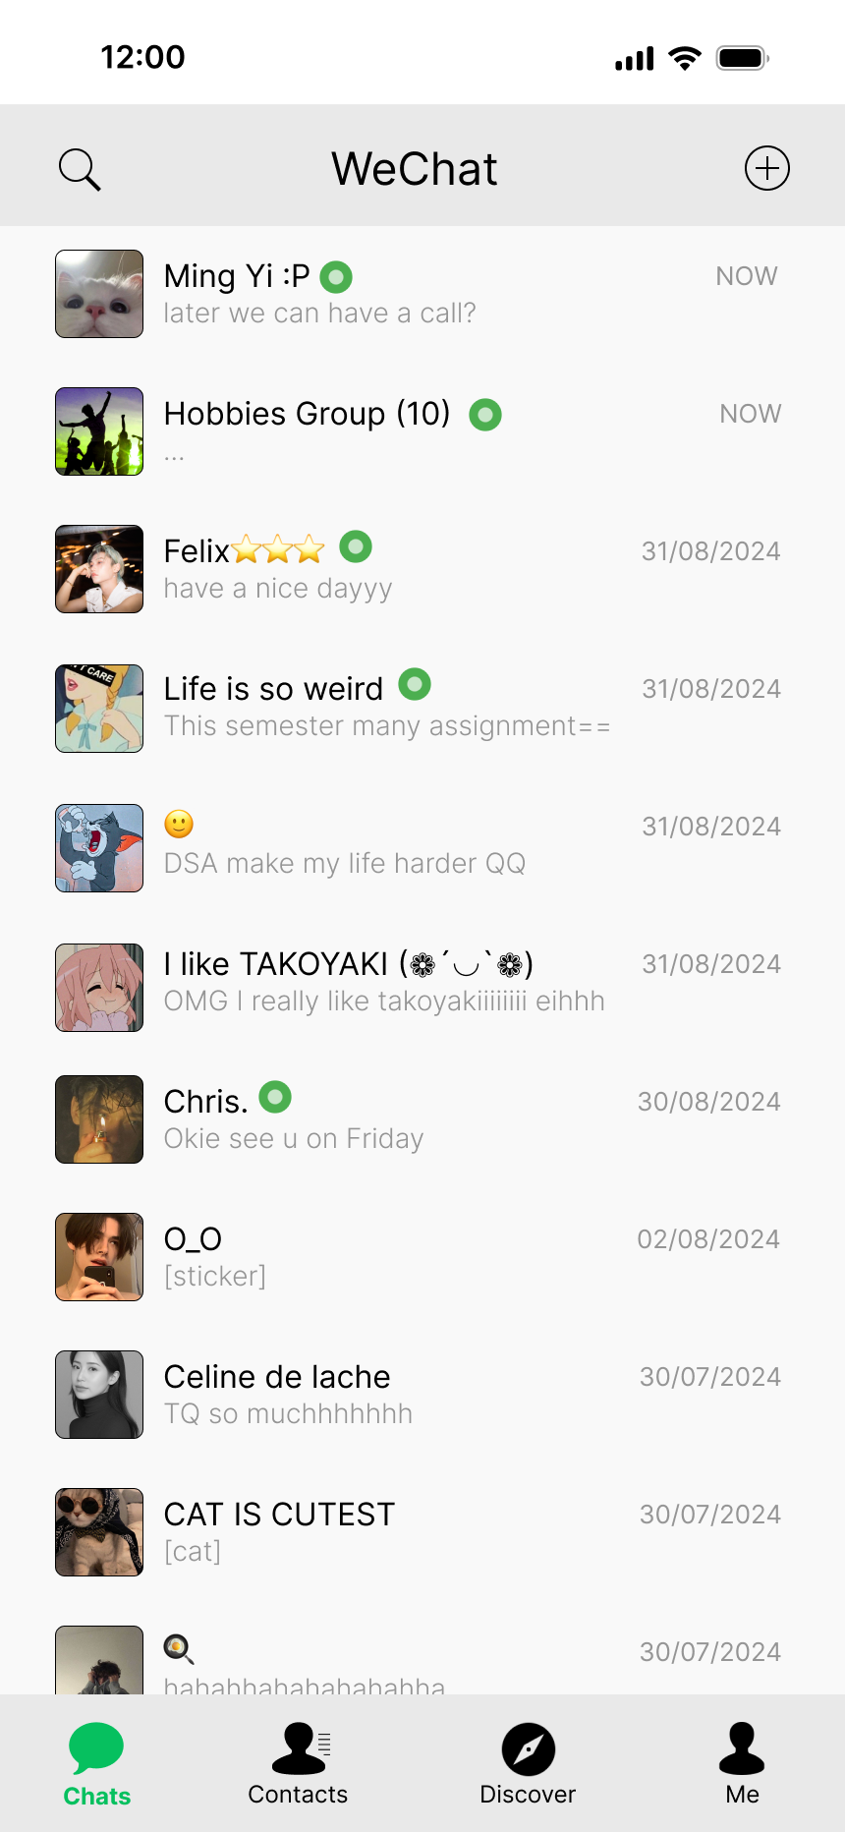
Heuristic Evaluation
1. Visibility of system status
A green color round shape icon beside the people’s name in the chat row. When the specific user is currently online, the icon will be shown. In contrast, the icon will be hidden when the user is offline.

Slide 49
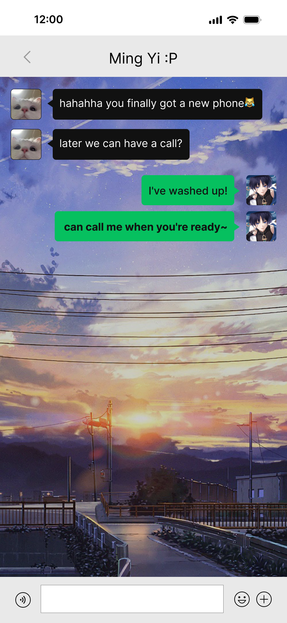
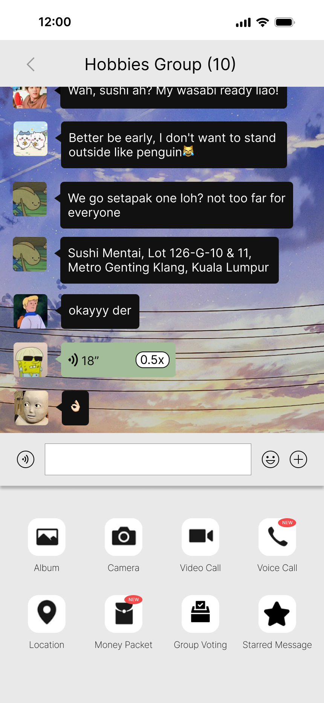
Heuristic Evaluation
2. Match between system and the real world
All the messages are appeared in a linear and back-and-forth format, mimicking the real life conversation natural flow. This can ease users to follow the pace when conducting conversation with a single person or a group of people. Besides, the icon images applied in the bottom section of the conversation interface have also followed this principle. All the images can be related to real-world objects.

Slide 50
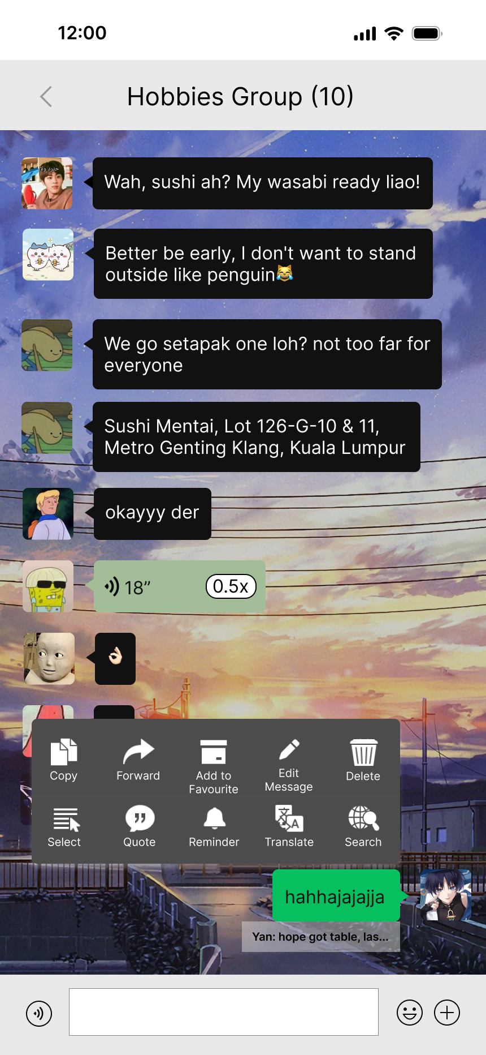
Heuristic Evaluation
3. User control and freedom
As a human, we are not able to absolutely guarantee that no mistakes or errors will be made when typing messages to others. In order to overcome this situation, a feature which allows users to edit sent messages is provided.

Slide 51
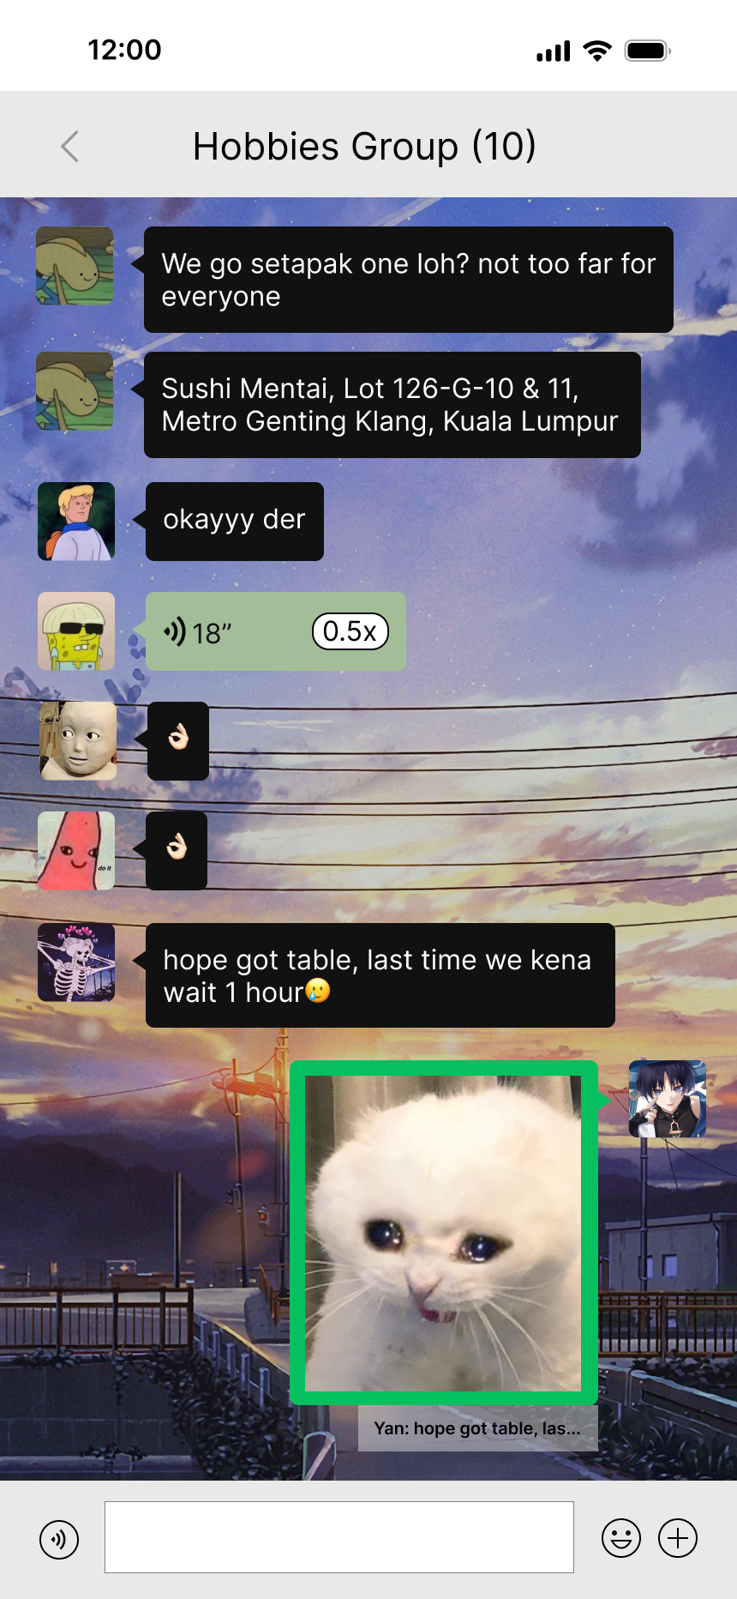
Heuristic Evaluation
4. Consistency and standards
In order to increase users’ readability and familiarity when dealing with the system, a standard layout for every conversation page is applied no matter if it is group chat or personal chat.

Slide 52
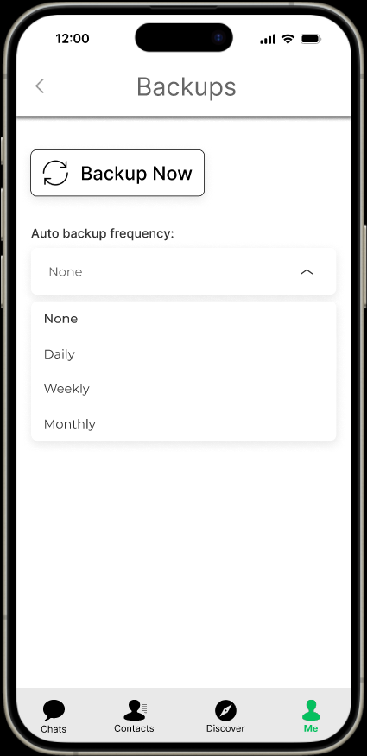
Heuristic Evaluation
5. Error prevention
For the auto backup feature, we only provided closed options for users to choose their wanted frequency such as daily, weekly and monthly auto backup instead of letting them enter the specific date time for auto backup. The main reason for this implementation is to reduce the possible errors that might be made by the users.

Slide 53
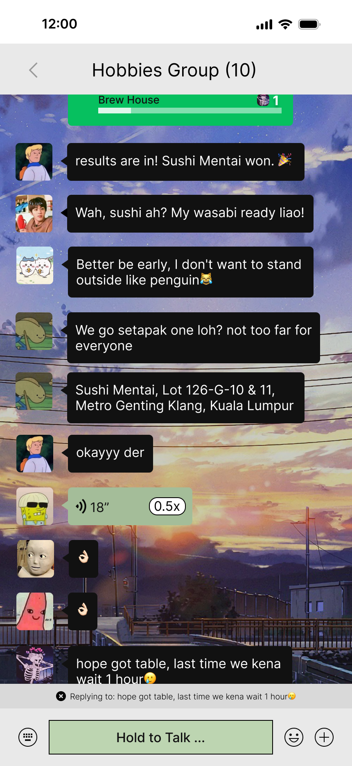
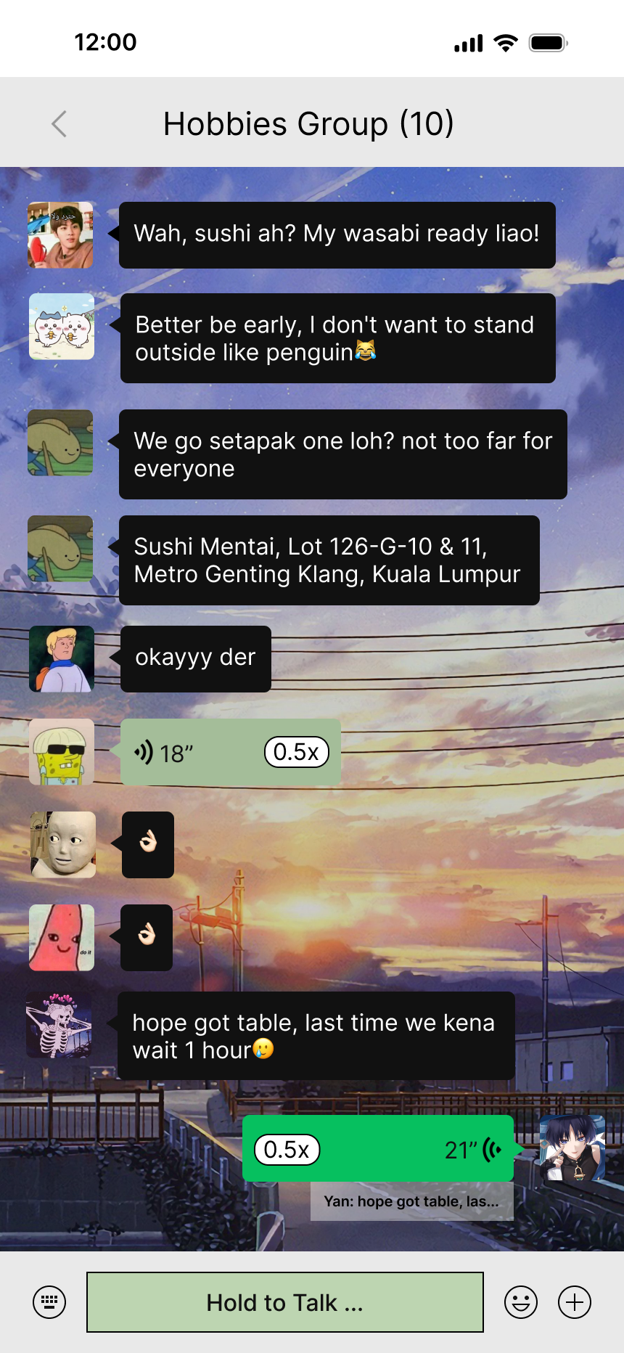
Heuristic Evaluation
6. Recognition rather than recall
After replying to a quoted message, the users can still tap on the reply message box (white transparent) below the sent message (green) to automatically navigate them to the replied message. The users no need to remember which messages are regarding which or who’s messages.

Slide 54
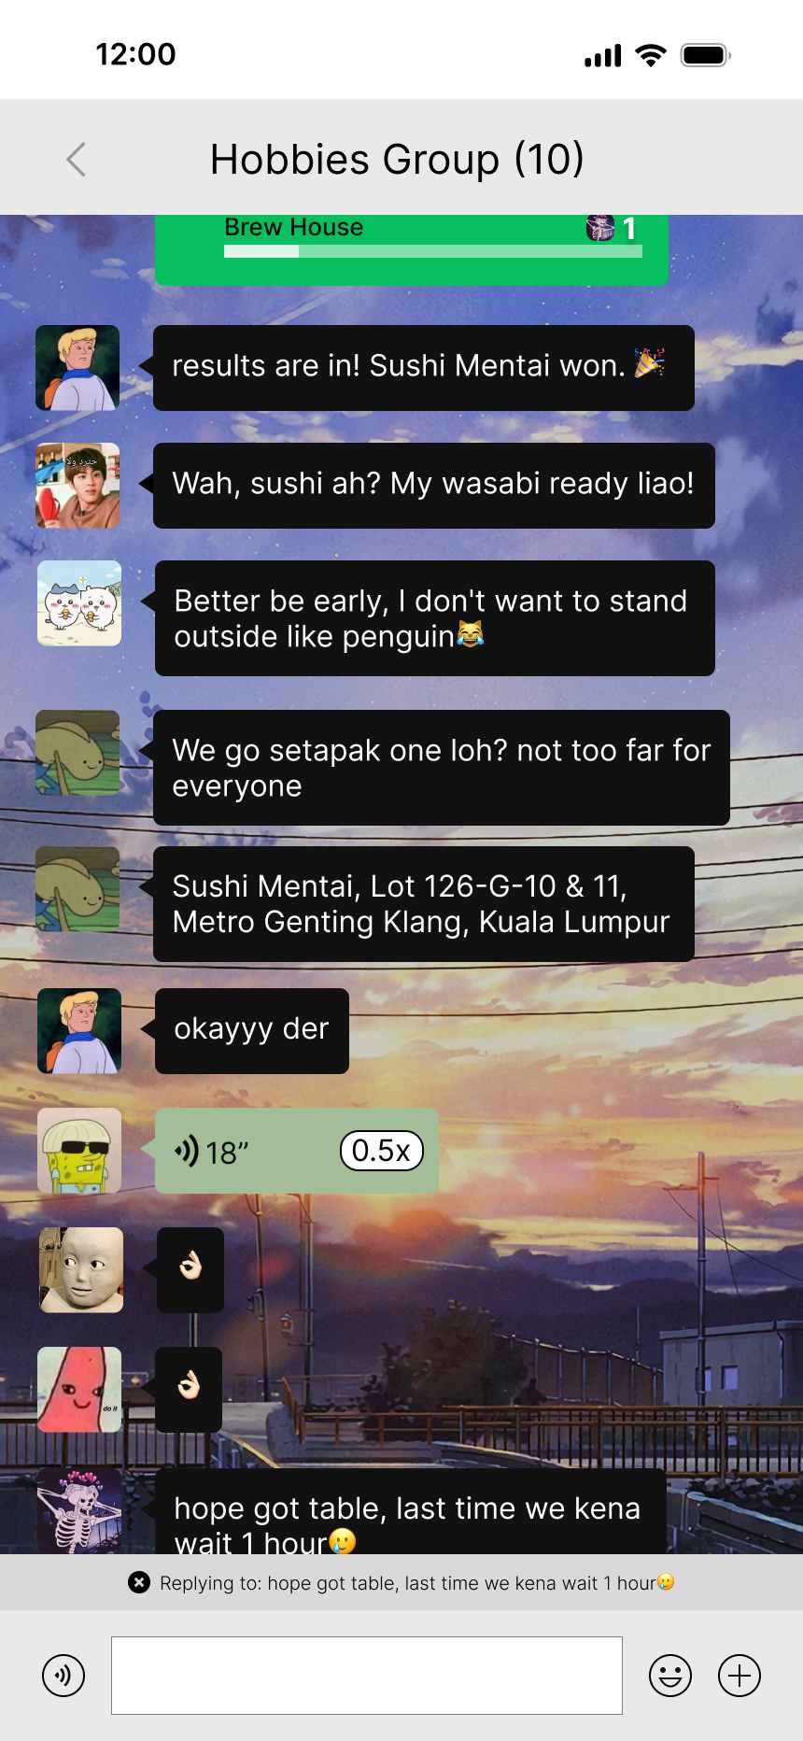
Heuristic Evaluation
7. Flexibility and efficiency of use
Two ways for different types of users to reply to a message:
For inexperienced users, they can long press on the message to reply to, and tap on the “Quote” button.
For the experienced users, they can just drag on the message to reply to, then the message is automatically quoted.

Slide 55
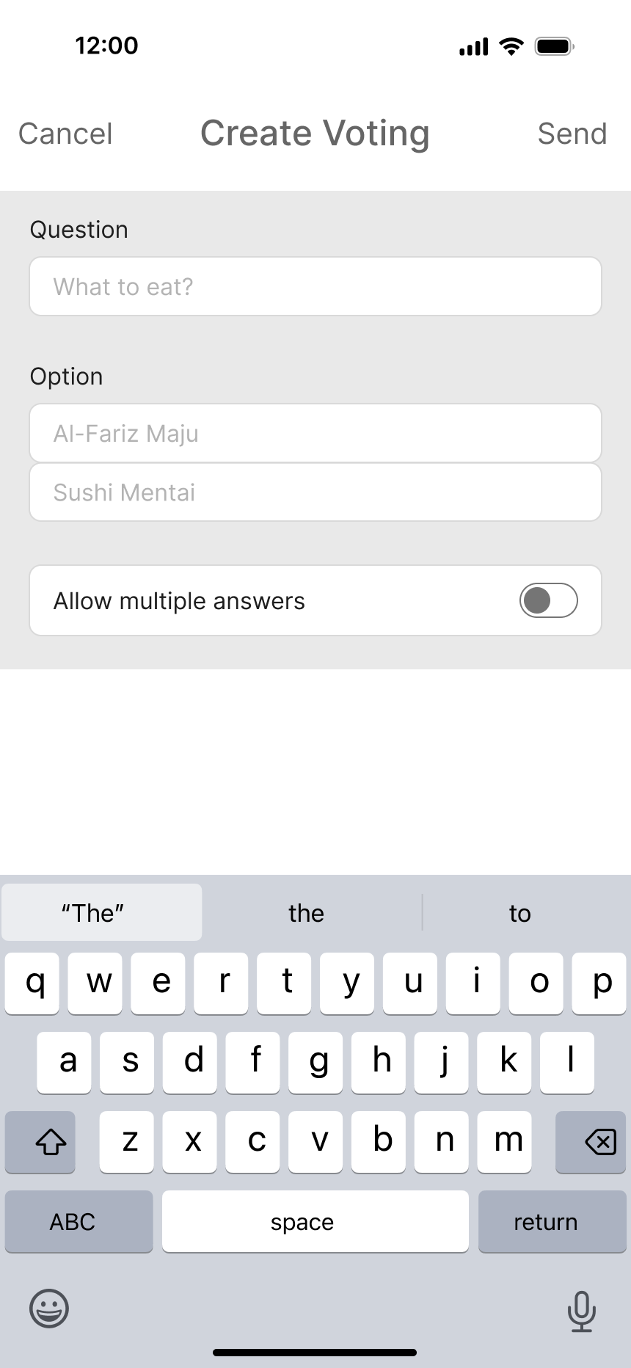
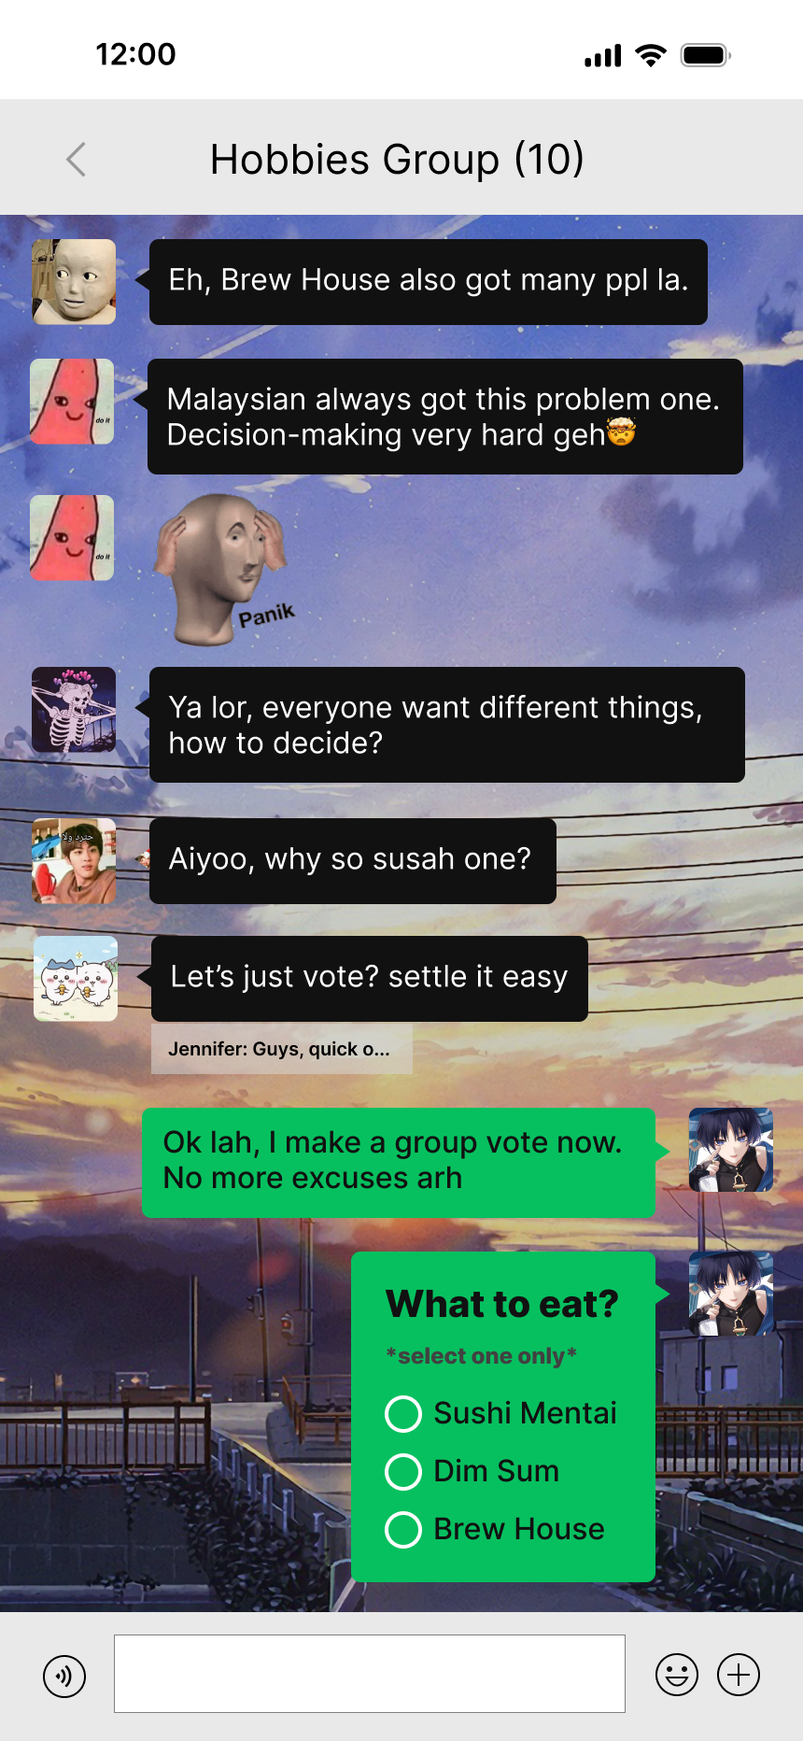
Heuristic Evaluation
8. Aesthetic and minimalist design
Most of the time, users will prefer to see the interface context that is simple, important, understandable and relevant only. This aesthetic and minimalist design on the create voting interface shows the crucial data fields, which allows users to immediately know what data they should fill into in order to successfully create a voting.

Slide 56
Heuristic Evaluation
9. Help users recognize, diagnose, and recover from errors
We do not implement this principle in our design. However, it should be included in the design in future. This is because it is crucial for acknowledging users when they have made some mistakes or missed out some crucial data field.
10. Help and documentation
We do not implement this principle in our design. However, this principle is crucial for being applied in the design in future. This is because it can provide some important information for users to refer to when users are dealing with some issues dealing with the system.

